Slide 1
West Valley Nuclear Waste Site
Erosion Modeling Update
26-27 March 2024
New York State Professional Geological Services PLLC
Thomas J. Morahan, PG

Slide 2
Background
Team
Thomas J. Morahan, P.G.
Raymond C. Vaughan, Ph.D., P.G.
Shannon Seneca, Ph.D.
Jason Hanania
Kit Cross

Slide 3
WEST VALLEY NUCLEAR WASTE SITE
WEST VALLEY NUCLEAR WASTE SITE
Operated as a nuclear reprocessing plant (1965 to 1972) and burial site for radioactive waste (1963 to 1975). No new waste has arrived at the site since 1975. Maintenance and remedial work since then.
The site is about 6 square miles of state-owned land in Ashford. Most of this is buffer zone surrounding about 200 acres occupied by the two unlined burial grounds (SDA and NDA) and other facilities such as the reprocessing plant that’s now being demolished.
SDA = State-Licensed Disposal Area (15 acres), containing about 2.4 million cubic feet of waste
NDA = NRC-Licensed Disposal Area (8 acres)

Slide 4
WEST VALLEY NUCLEAR WASTE SITE
WEST VALLEY NUCLEAR WASTE SITE
A site-specific federal law (the West Valley Demonstration Project Act) was passed in 1980 to solidify 600,000 gallons of high-level liquid waste (HLLW) and clean up part of the site. DOE and NYSERDA have safely vitrified the HLLW.
This was done by mixing radioactive material from the HLLW into melted borosilicate glass and pouring the hot glass mixture into stainless steel canisters, in order to make highly radioactive glass that is physically stable and resistant to leaching.
Vitrified waste is still onsite but relatively safely stored – must eventually be removed.

Slide 5
WEST VALLEY NUCLEAR WASTE SITE
No decision yet on whether the SDA and NDA burial grounds will be dug up and removed. Decision may be made in about 2 years?
Franks Creek and Erdman Brook run alongside both burial grounds, and these two creeks are actively eroding.
Both creeks are becoming deeper and wider as they erode. At some point in the future they will cut into the sides of the burial grounds and start carrying wastes downstream – but how soon?
A 1996 prediction by DOE and NYSERDA showed severe future erosion. Their 2005-2010 prediction showed much less erosion. Which one to trust?

Slide 6
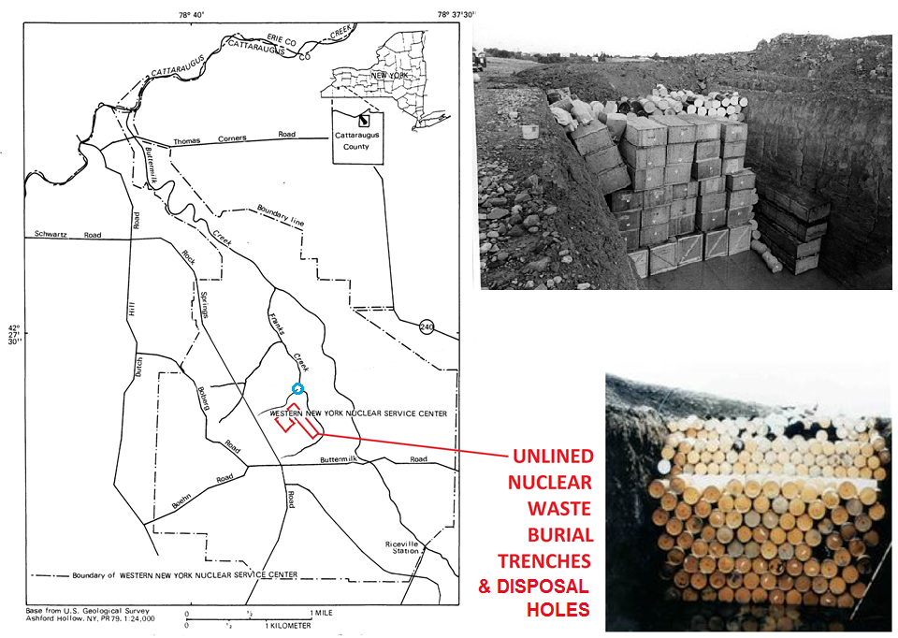
Map adapted from Bergeron, USGS, 1983

Slide 7
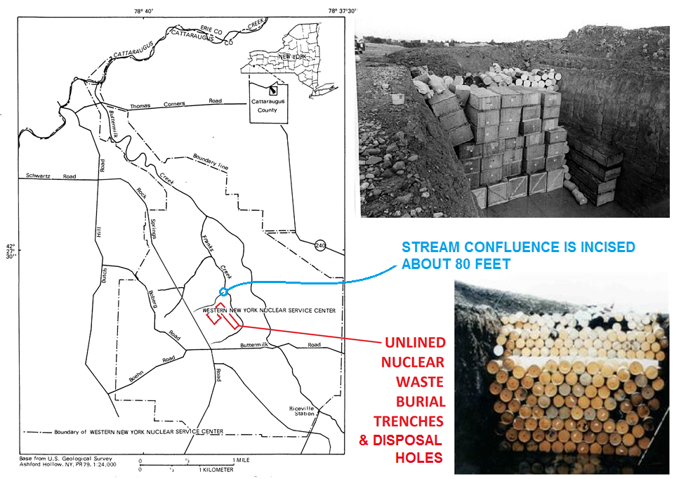
Map adapted from Bergeron, USGS, 1983

Slide 9
Town of Ashford Hydro/Erosion Model Objectives
Develop a Model to Help Estimate
Long-term Erosion Scenarios
10,000 Years
Recognizing Cohesive Sediments
The Effects of Climate Change
Rainfall
Snowmelt

Slide 10
Choice of a Model To Use
Model Options
United States Environmental Protection Agency (USEPA)
Advanced Geospatial Watershed Analysis (AGWA) Model
USDOE / Neptune
Hydrologic Models
WGEN - Weather
HELP - Landfill Performance
FEHM - Groundwater Movement
SWAT - Water and Sediment Transport
Probabilistic Performance Assessment
GoldSim - Integrated Transport Model
United States Army Corps of Engineers (USACE) Hydraulic Engineering Center (HEC)
Hydrologic Modeling System (HMS)
River Analysis System (RAS)
Model Choice
United States Army Corps of Engineers (USACE) Hydraulic Engineering Center (HEC) River Analysis System (RAS)
HEC-RAS is a robust, well-documented model that best supports volumetric sediment transport

Slide 11
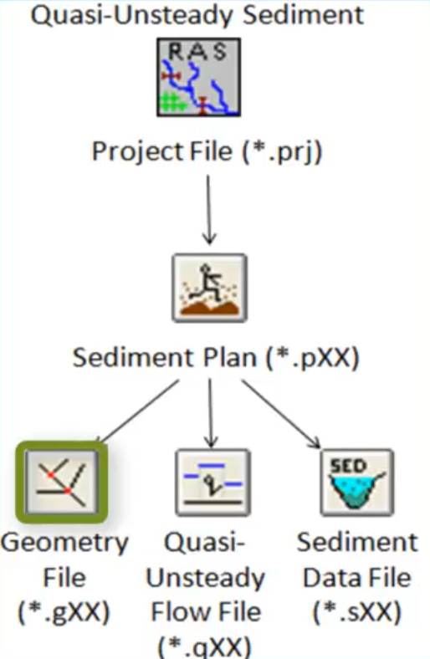
HEC RAS Model Development
Geometry
Flow
Sediment
Plan
Allows Different Model Assumptions
2D Model Option

Slide 12
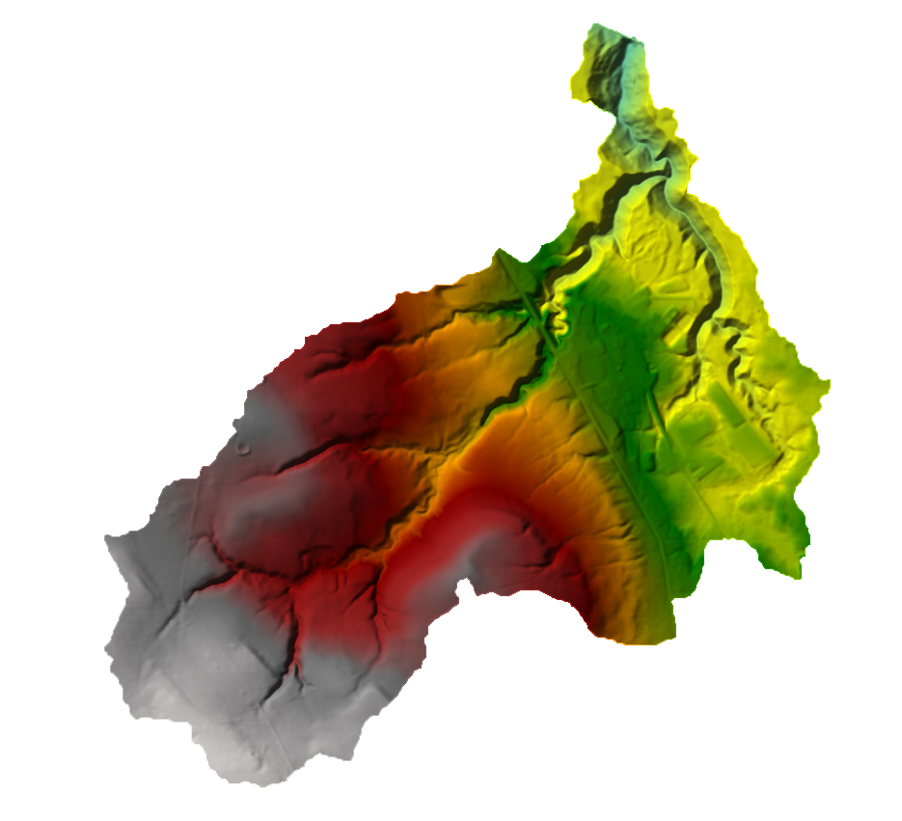
HEC RAS Geometry
NYSERDA LiDAR Data
Digital Elevation Model
Plus
Land Use
Cover
Soil Types

Slide 13
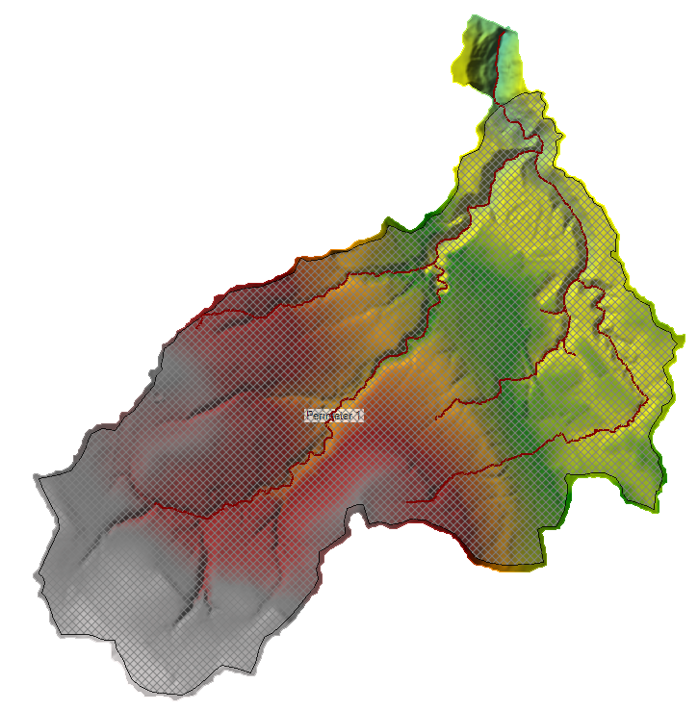
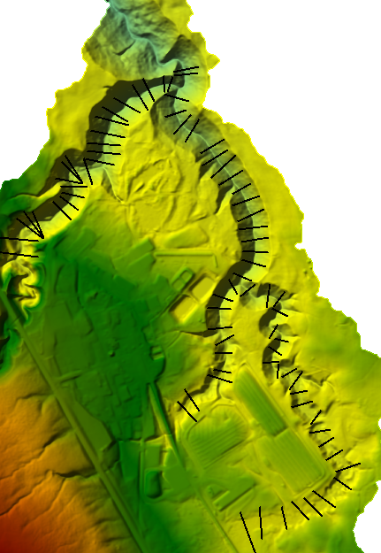
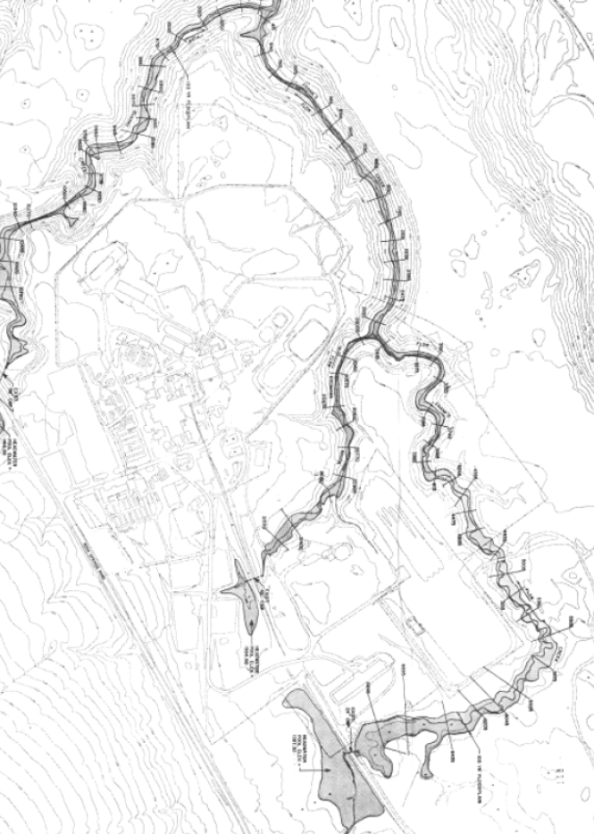
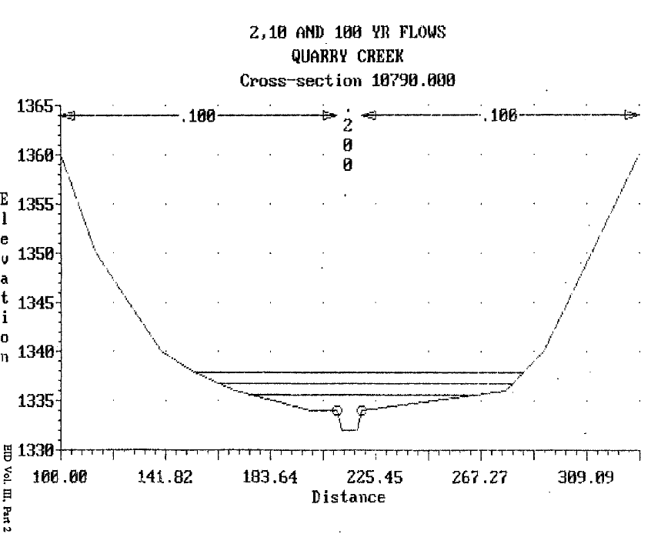
HEC RAS Geometry
2D Mesh
For Computations
Cross Sections of Stream Bottoms
Franks Creek
Erdman Brook
Quarry Creek

Slide 14
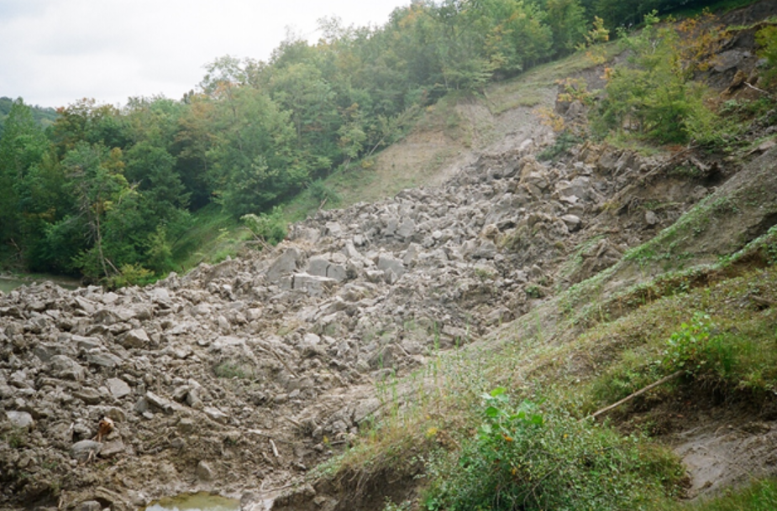
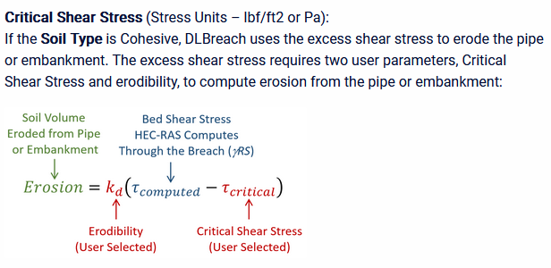
HEC RAS Flow
2009 Storm - Buttermilk Creek
Demonstrated Cohesive Sediment Complexity
Dessication of Till Fractures
Current Hydro Model
Unsteady Flow
Quasi Unsteady Flow
Best for Sediment Transport
More Stable
Handles Cohesive Sediments
Requires Additional Data
Shear Stress
Grain Size Distribution
Conceptual Site Model
Erosion Exposes Different Geology
Fence Diagram from Boring Logs
Transects Under Development

Slide 15
Geological Cross Section

Slide 16
Current Flow Model Showing 2-year Storm Event

Slide 17
Current Flow Model Showing 500-year Storm Event

Slide 18
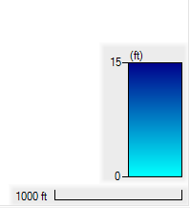
Current Flow Model Showing 24 Hour Event Water Depth
Year
0
5
25
50
100
500

Slide 19
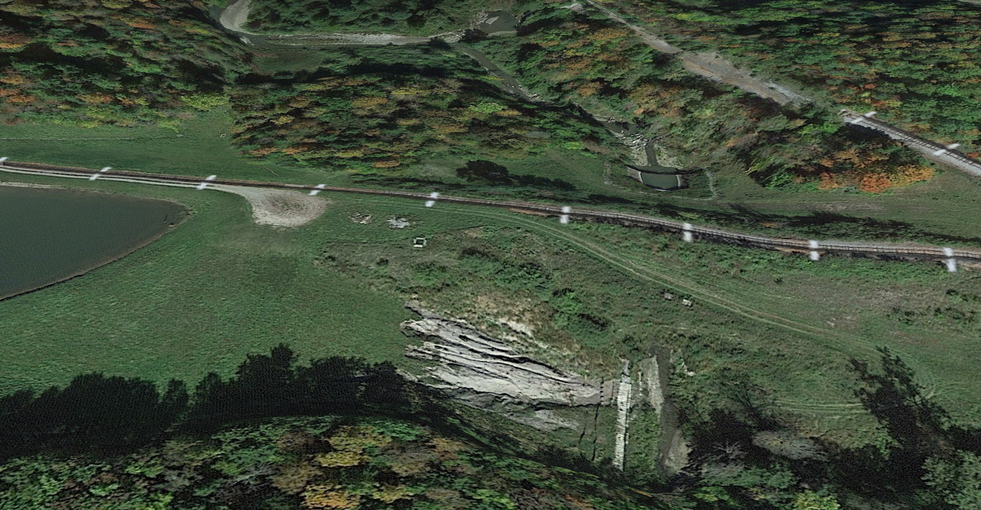
Recent Storm Events on Buttermilk Creek Validate Flows
Sediment mass removal

Slide 20
Next Steps
Develop Quasi Unsteady Flow Model
Transport Parameters (e.g. shear stress, grain size)
Validate Storm Event Data
Update Model with Climate Change Data
Climate Change Estimates Using Atlas 14 or Other Data
Snowmelt Considerations
Develop Sediment Erosion Data
Cumulative Volume of Sediment Removed
Estimate Future Topography
Develop Report

Slide 21
Questions
Thomas J. Morahan, P.G.
Buffalo, NY
716 (374) 0640

